Slide 1

Pharmacy Data-Driven Insights and Decisions
for a Better Future
Rakshith Rao Rangineni Section 100 - Class Nbr 11796 8 W1-Fall 2023

Slide 2
Executive Summary
The pharmacy wholesale dataset you have provided contains information about pharmacy orders, including the drug name, dosage type, route, market segment, distributor, dispensed region, state, pharmacy rep, zip code, units sold, retail sales price, total order revenue, MSRP, total order revenue at MSRP, wholesale cost, total wholesale cost, order gross profit, order gross profit at MSRP, order gross profit margin, and order gross profit margin at MSRP.
Gross profit in 2014 is the maximum, Therefore, the pharmacy business was most profitable in that year.
Idaho was the top revenue-generating state, suggesting that there is a strong demand for pharmacy products in that state.
Cream dosage type was the top revenue-generating dosage type which is 30 %, suggesting that this type of product is in high demand.
New York had the highest gross profit, suggesting that pharmacies in this state are able to negotiate favourable prices with distributors.
Drug_76, Drug_341, and Drug_841 were the top-selling drugs, suggesting that these products are popular with consumers.
Analysis of revenue and units sold over multiple years revealed intriguing trends. While 2012 had the highest units sold, 2014 stood out with peak revenue, indicating that high unit sales didn't guarantee the highest revenue.
Distributor B outperforms Distributors A and C in both unit sales and gross profit, highlighting a strong correlation between higher unit sales and increased profitability.
Distributor B generated the most revenue, suggesting that this distributor has a strong customer base.

Slide 3
Yearly Gross Profit Trends
The graph reveals an interesting pattern in yearly gross profit trends. In 2014, there was a remarkable spike in gross profit, suggesting a significant boost in profitability during that year.
Equally noteworthy is the fact that in both 2013 and 2015, the gross profit remained consistent. This consistent performance may indicate stable financial results for those years.

Slide 4
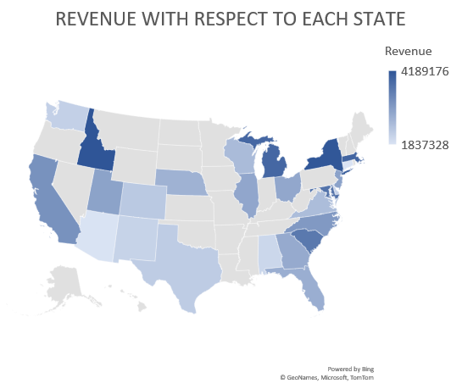
Revenue Generated in each state
Idaho generated the highest amount of revenue, followed by Michigan and New York. This suggests that pharmacies in these states are ordering more drugs from wholesalers.

Slide 5
The Top Dosage Type
The data shows that cream, concentrate, capsules, and a variety of other dosage types make up the majority of the distribution.
Cream and concentrate holds the largest share at 30% and 9%, followed by capsules at 12%, while the remaining 50% indicates a diverse array of other dosage types. This distribution reflects a mix of consumer preferences and market demand for different forms of medication or products.

Slide 6
Gross Profit with respect to each state
New York generated the highest amount of gross profit, followed by Idaho and Michigan. This is because size of the market, the types of drugs that are commonly prescribed in this state, or the efficiency of the pharmacy distribution system.

Slide 7
Number of Units sold
Drug_76, Drug_341, and Drug_841 were the top 3 drugs that sold the most units. This is because of the effectiveness of these drugs and the marketing efforts of pharmaceutical companies.

Slide 8
Revenue and Units Sold Analysis Over Time: A Yearly Comparison.
The data suggests that high unit sales in 2012 did not directly translate into peak revenue, as 2014 witnessed the highest revenue, despite not having the highest units sold.
The sudden drop in revenue in 2015 might indicate a shift in market dynamics or an internal issue affecting sales, which continued to impact revenue in the subsequent years.

Slide 9
Distributor Analysis
The graph illustrates a clear correlation between higher unit sales and increased gross profit, with Distributor B outperforming both A and C in terms of units sold and gross profit. This suggests that the higher sales volume achieved by Distributor B has a direct impact on their profitability, making them a key contributor to overall revenue.

Slide 10
Top Distributor
Distributor B generated the highest amount of revenue, followed by Distributor A and Distributor C. The size of Distributor B's customer base, the types of drugs that Distributor B distributes, or the efficiency of Distributor B's operations these are the main reasons why distributor B is the highest.

Slide 11
Recommendation Slide & Story Flow of Pharmacy Data
Focus on Cream Dosage Type: Allocate resources and marketing efforts towards the cream dosage type, which accounts for 30% of total revenue. This dosage type demonstrates in more demand and high profitability.
Idaho Market: Given that Idaho is the top revenue-generating state, direct more resources and marketing efforts toward this state to tap into the strong demand for pharmacy products.
Optimize Distributor Relationships: Leverage the negotiating power demonstrated in New York to secure favourable pricing with distributors across all regions. This can positively impact overall gross profit margins.
Promote Top-Selling Drugs: Implement targeted marketing strategies for Drug_76, Drug_341, and Drug_841, as they are top-selling products. This can further enhance sales and revenue.
Analyse 2012 vs. 2014 Performance: Conduct a detailed analysis to understand the factors contributing to the higher revenue in 2014 compared to the year with the highest unit sales in 2012. This will provide insights for future sales strategies
Learning Distributor B’s ideas: Distributor B generated the most revenue, consider expanding strategies that enhance customer relationships to drive business growth.
Revenue vs. Unit Sales: Recognize that high unit sales don't always equate to maximum revenue. Evaluate the factors that contributed to the revenue peak in 2014 despite lower unit sales in that year.
Customer Engagement and Retention: Develop strategies to strengthen relationships with customers in regions where the business is performing well. This can include marketing & promotions etc.

